Slide 1
Let’s Make Crescent Rolls
Series Category – Adaptive Food Prep
Series Creation Focus – Staple Foods/Crescent Rolls
Diagnosis Focus – Rheumatoid Arthritis
Symptom Focus – Arthralgia, Athenia, Ataxia & Bone Pain

Slide 2

Situation
“Ok, so here’s the SITUATION. A person has Rheumatoid Arthritis. This person is experiencing symptoms such as joint pain, weakness in hands and fingers, difficulty coordinating muscle movement in hands and joints, and deep bone pain with movement. This makes it difficult for this person to make food. This person is making crescent rolls.”

Slide 3
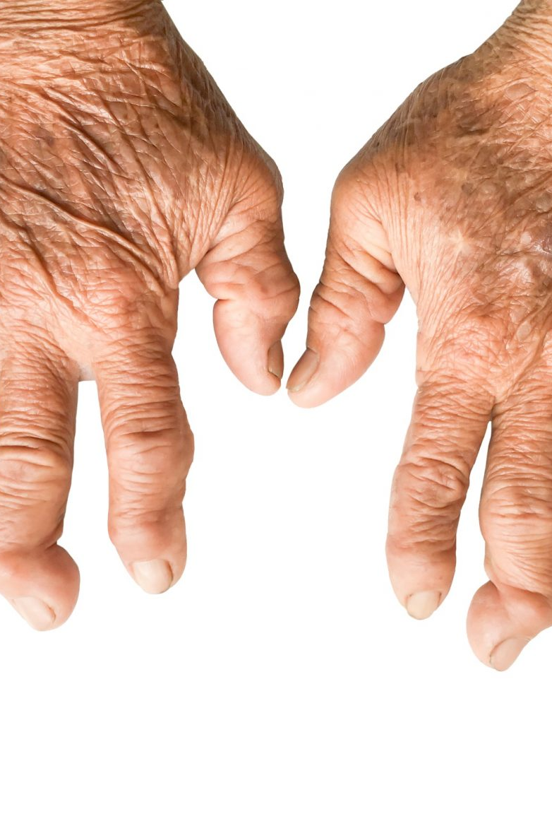
Background
“Alright, so here is some BACKGROUND that’s important about this:”
People who are experiencing Rheumatoid arthritis will often have finger joints that are bent in awkward positions, swollen hands and fingers, and will often have a lot of pain and difficulty moving their fingers and hands.

Slide 4
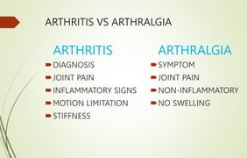
Background
Those who are living with Rheumatoid Arthritis will very often experience a symptom called Arthralgia
Arthralgia is pain in joints.

Slide 5
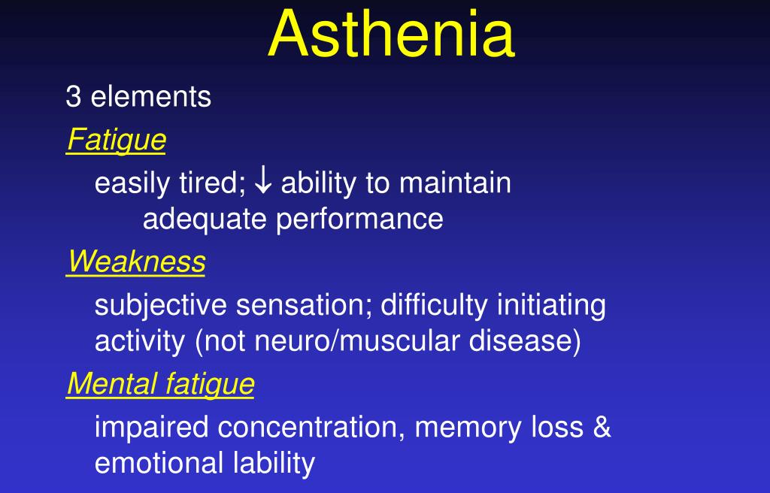
Background
Those who are living with Rheumatoid Arthritis will very often experience a symptom called Asthenia
Asthenia is weakness or lack of energy and strength.
This can make a person easily fatigued, and make it difficult to complete multiple complicated steps to food prep

Slide 6
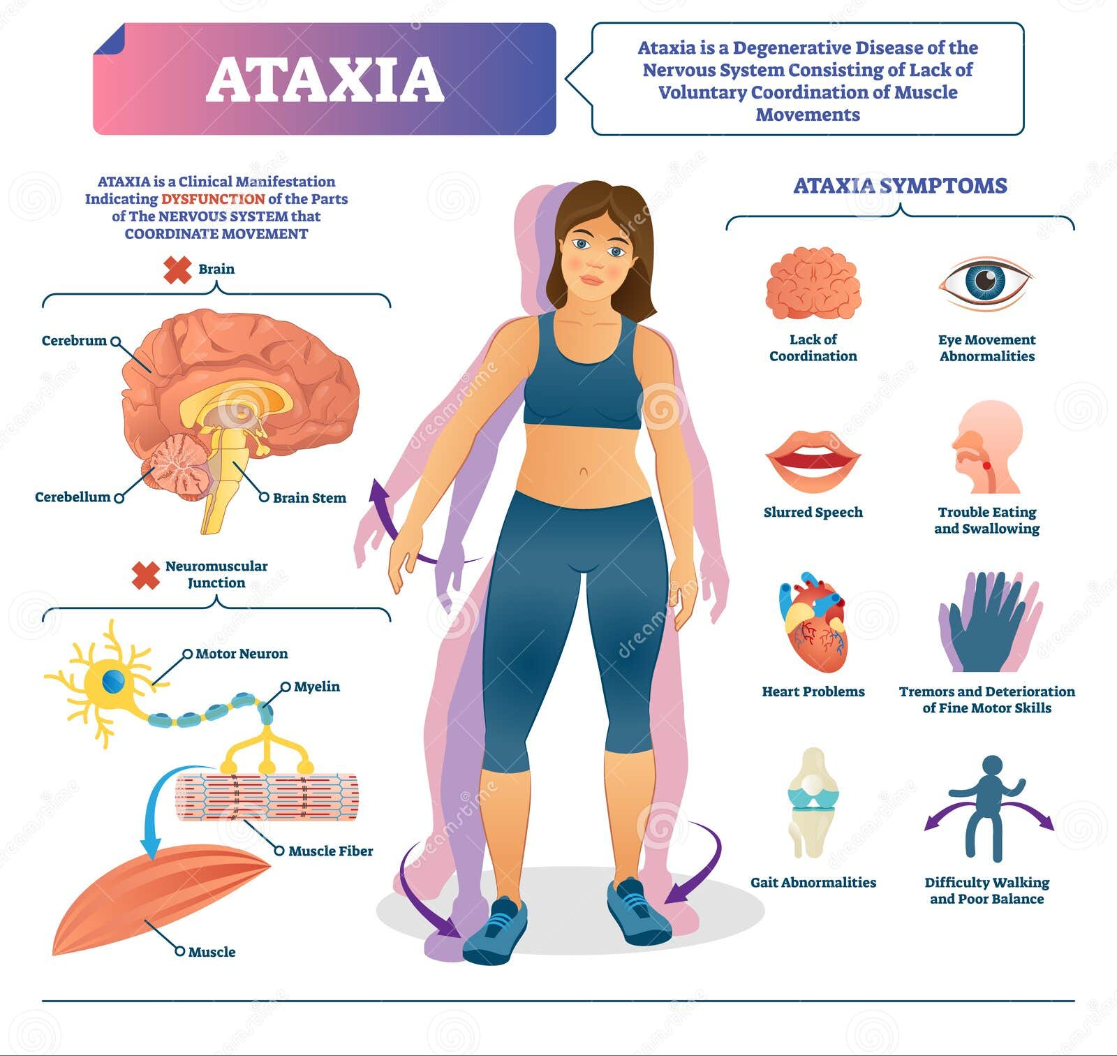
Background
Those who are living with Rheumatoid Arthritis will very often experience a symptom called Ataxia
Ataxia happens when a person has difficulty coordinating how muscles work together. This can lead to clumsiness or awkward repetitive movements.

Slide 7
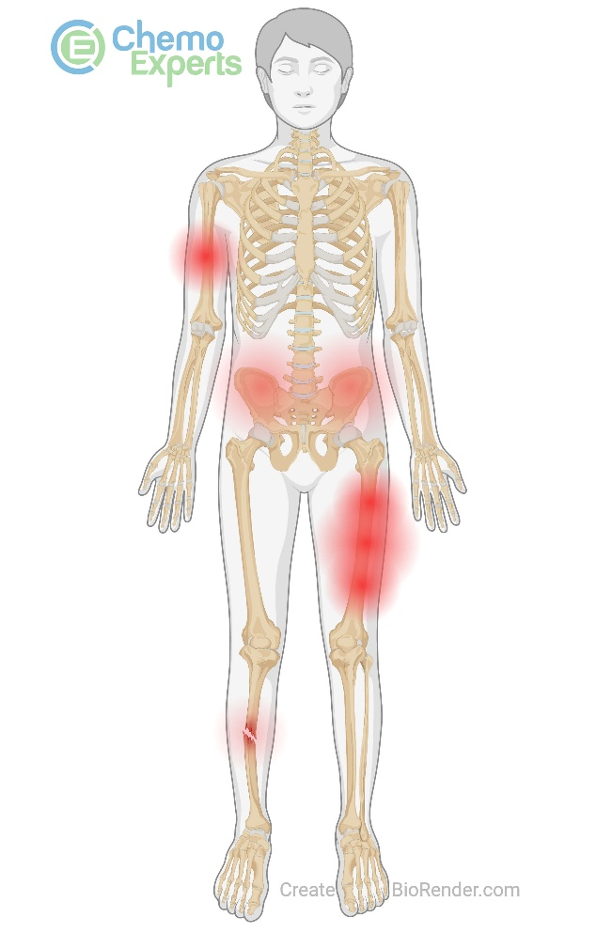
Background
Those who are living with Rheumatoid Arthritis will very often experience a symptom called Bone Pain
Bone pain is a dull, achy pain deep inside the body. Those experiencing it endorse feeling the pain in their joints or bones.

Slide 8

Background
Many kinds of people can experience these symptoms, young and old.

Slide 9

Assessment
“So, here’s my ASSESSMENT- These adaptive tools:
Silicone cupcake liner
Rubber jar opener
Piece of a pool noodle
Knotted rope dog toy
Velcro based grip assist devices
Grabbing device/grip assist device
Mezzaluna or Ergonomic kitchen knife
Silicone kneading bag or two-gallon plastic freezer bag

Slide 10
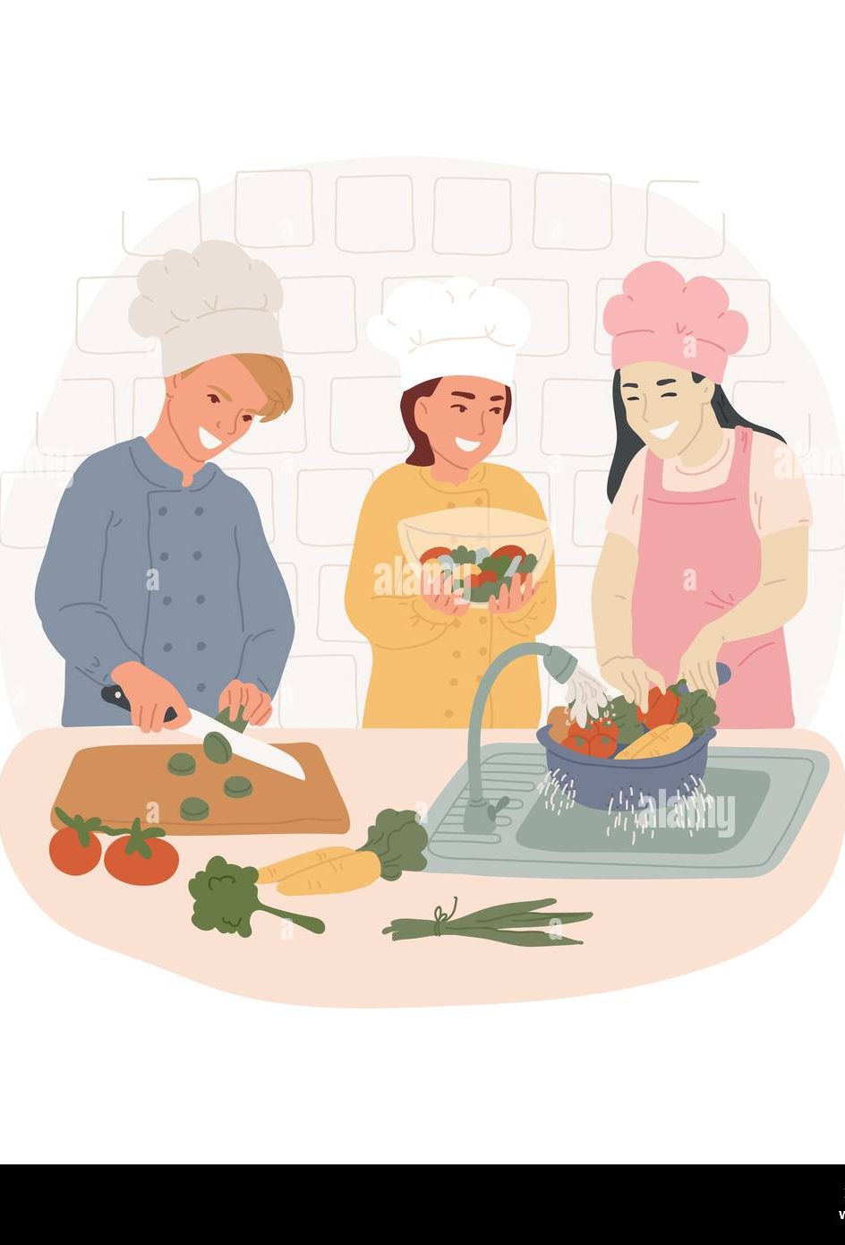
Assessment
Can help this person who has:
Rheumatoid Arthritis- This person is experiencing joint pain, difficulty coordinating movements, and weakness with their task.
These adaptive tools can help with energy conservation techniques
To protect a person from harm from overexertion
Complete the steps safely
And help make task completion easier
Person has all the items to do this and needs instruction.

Slide 11
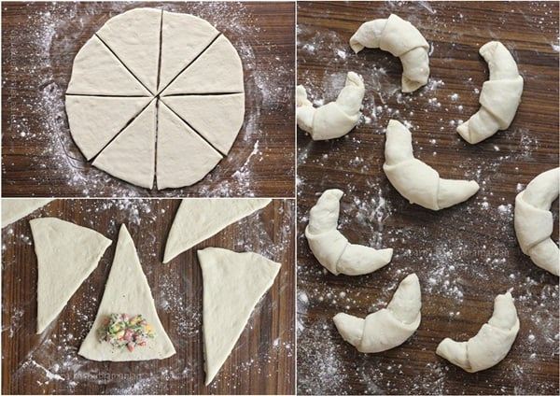
Recommendations
“Well, here’s my RECOMMENDATIONS”
“I’m going to show you how to make crescent rolls right now, using these adaptive tools.”
This Photo by Unknown Author is licensed under CC BY-NC-ND

Slide 12

Let’s Gather Our Supplies
Equipment:
Big bowl
Measuring Cup
Measuring spoons (teaspoon & tablespoon
Fork/whisk
Dough scrape
Wide knife
Nitrile gloves (optional)

Slide 13
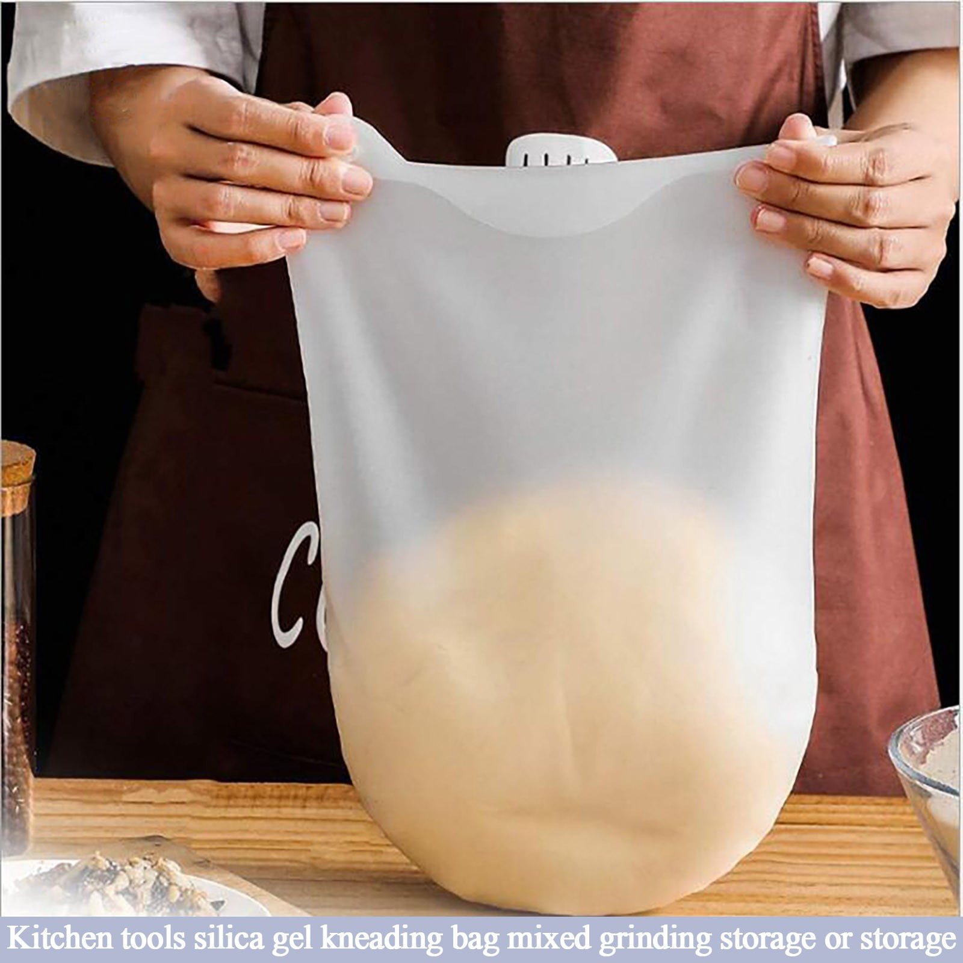
Let’s Gather Our Supplies
Adaptive Tools:
Silicone cupcake liner
Rubber jar opener
Piece of a pool noodle
Knotted rope dog toy
Velcro based grip assist devices
Grabbing device/grip assist device
Mezzaluna or Ergonomic Kitchen Knife
Silicone kneading bag or two-gallon plastic freezer bag

Slide 14

Let’s Gather Our Supplies
Ingredients:
4 & 1/2 cups flour
2 large eggs- beaten
½ cup warm water
1 Tb active dry yeast
½ cup milk
½ tsp salt
½ cup sugar
1 stick melted butter (1/2 cup)
butter or egg wash (beaten egg and warm water mixture) optional for top of bread

Slide 15

Let’s do this!
Step 1: Set up workspace
Set up adaptive tools

Slide 16
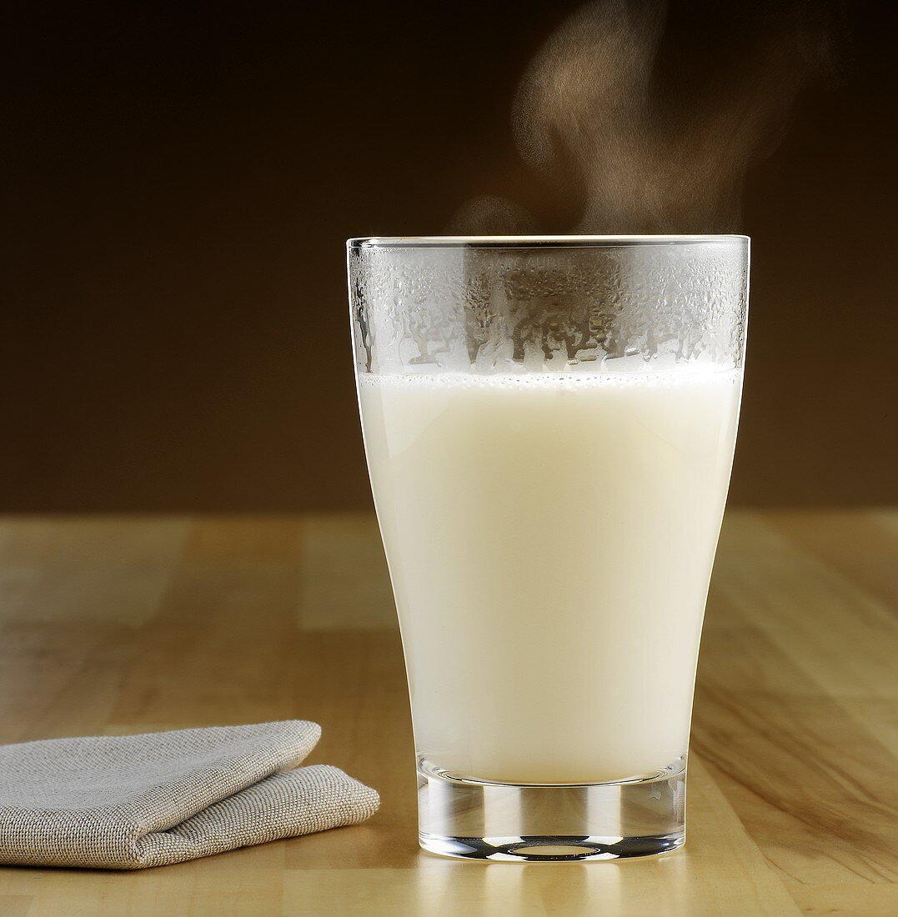
Let’s do this!
Step 2 -
Measure and combine your water & milk and warm it up to bath water temperature.
Don’t get it too hot or it’ll kill your yeast

Slide 17
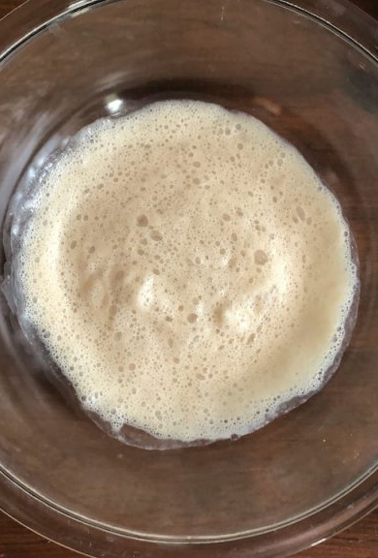
Let’s do this!
Step 3 -
Mix in your sugar, yeast, and salt into your milk/water. Let sit for 10 minutes until foamy

Slide 18
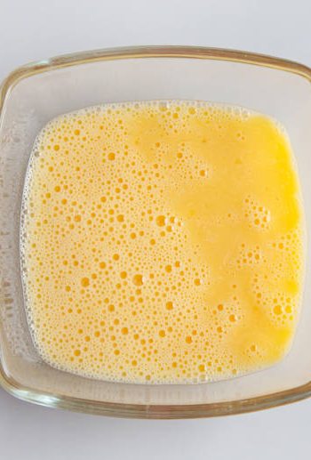
Let’s do this!
Step 4 -
Beat egg and set aside

Slide 19
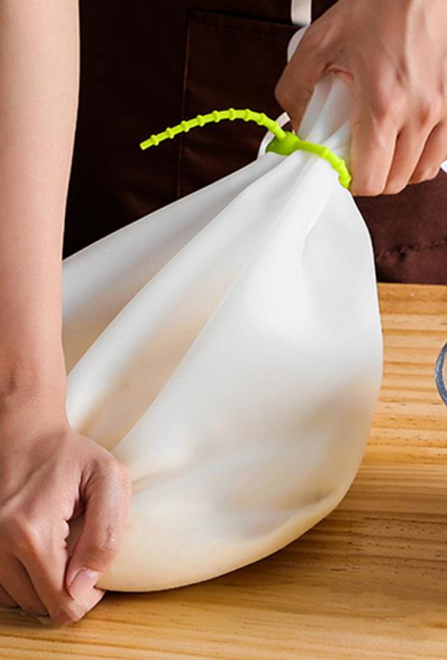
Let’s do this!
Step 5 -
Add flour into silicone or zip lock bag, pour in egg, and yeast/milk/water combination. Close/secure bag and knead until ingredients well combined (around 5-10 minutes).

Slide 20
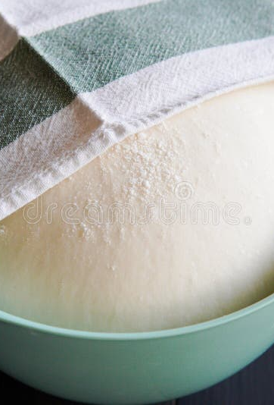
Let’s do this!
Step 6 -
Put dough into your oiled bowl. Flip it until the dough is covered in oil. Cover with towel and let dough rise for an hour.

Slide 21
Let’s do this!
Step 7 -
After an hour, go ahead and dump dough out on a floured surface. Punch down and roll dough out into a big circle. Cut it into 8-12 pizza looking slices.
Roll pieces into crescent rolls
This Photo by Unknown Author is licensed under CC BY-NC-ND

Slide 22
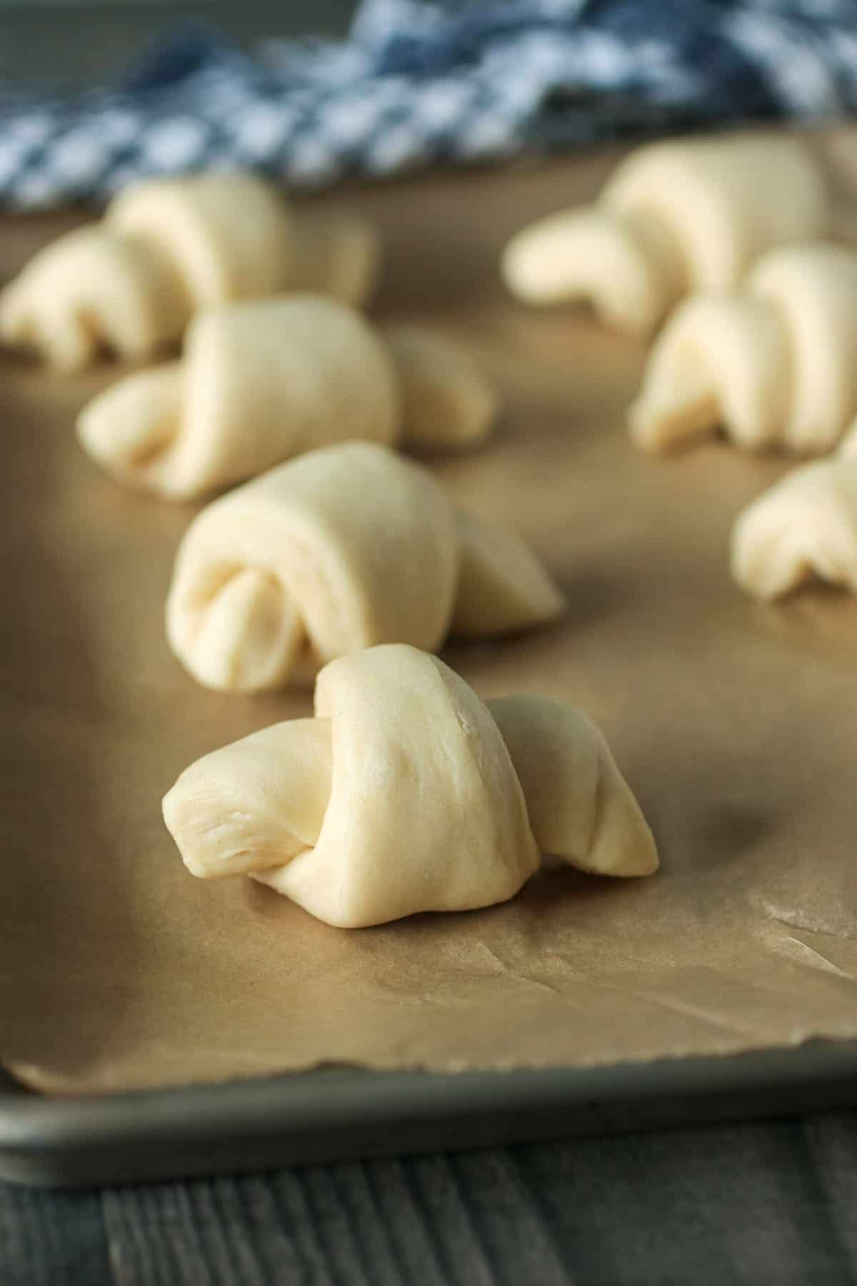
Let’s do this!
Step 8 -
Cover again, and let sit for 15-30 minutes
Go ahead and make your egg wash or melt your butter to brush on top of your dough

Slide 23
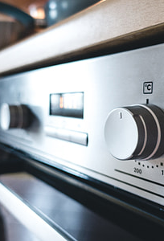
Let’s do this!
Step 9 -
Preheat oven to 375.

Slide 24
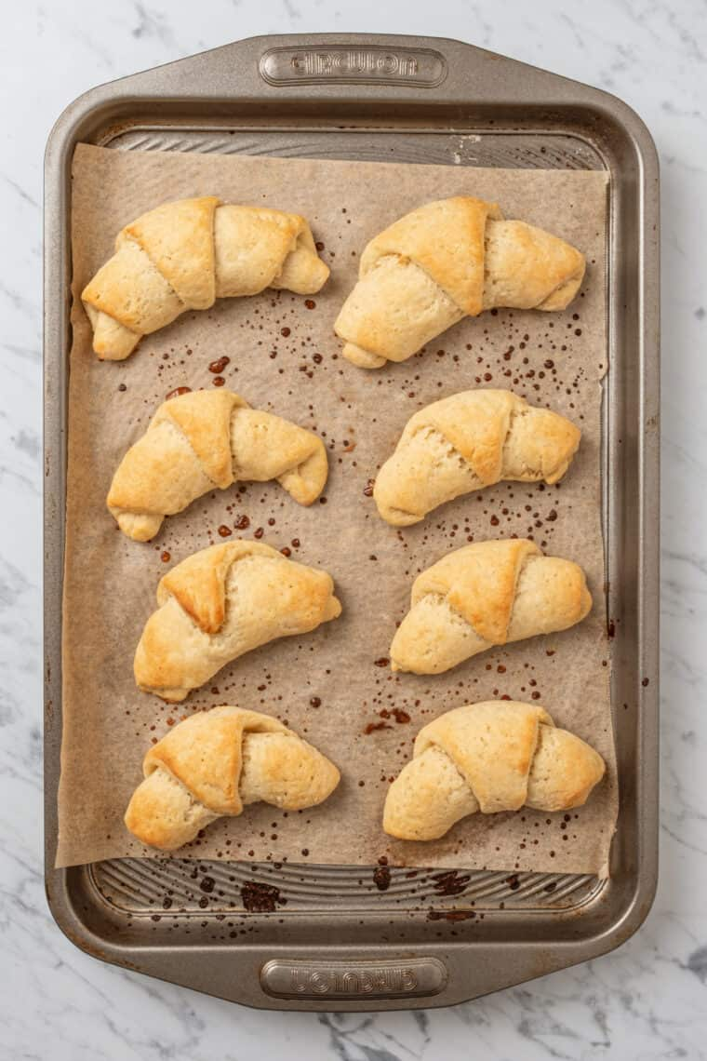
Let’s do this!
Step 10 -
Brush dough with your butter or egg wash, and place in oven. Cook for 8-11 minutes.

Slide 25
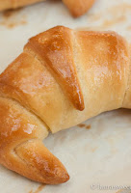
Let’s do this!
Step 11-
Allow cooked rolls to cool for 5 minutes. Enjoy!
This Photo by Unknown Author is licensed under CC BY

Slide 26

Legal Statements
Just a REMINDER, this is all just me trying to be helpful- things I’ve witnessed as a nurse that I’ve seen help some people, and some of these situations are things I’ve gone through myself with either me or a loved one that I’ve had the joy of figuring out this worked for us.

Slide 27

Legal Statements
I am not affiliated with the education I provide links to, and they’re not affiliated with me.
I just used it to either make this education or found inspiration in it.

Slide 28

Legal Statements
Nothing I post here is meant to diagnose or medically treat people. If you do resonate with some of these symptoms and need additional information on if you could be experiencing this, make sure you talk to your doctor or medical team.

Slide 29

Legal Statements
Any opinions I express are my own, and not the opinions of an employer.”

