Slide 1
Let’s Make Bagels
Series Category – Adaptive Food Prep
Series Creation Focus – Staple Foods/Bread
Series Adaptive Focus – loss of dexterity, and grip strength in hands
Series Symptom Focus – paralysis, spasticity, muscle weakness, neuropathy

Slide 2
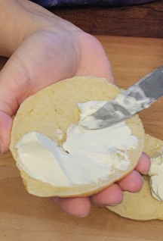
Situation
“Ok, so here’s the SITUATION. A person has spasticity, is paralyzed on one or both hands, has cerebral palsy, or has one way or another lost their grip strength in their hands that makes it difficult to prepare food. This person is making bagels.”

Slide 3
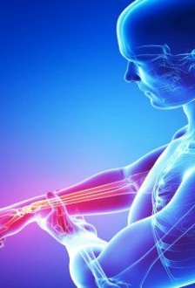
Background
“Alright, so here is some BACKGROUND that’s important about this:”
People are often born or develop different conditions that can cause muscle weakness or even tightness in the upper extremities or hands.

Slide 4
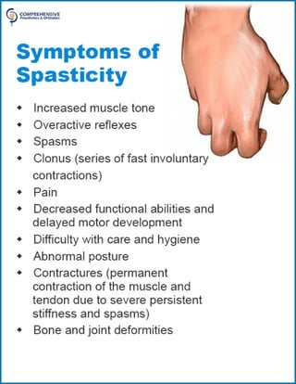
Background
Spasticity is a muscle disorder that causes stiffness or muscle spasms

Slide 5
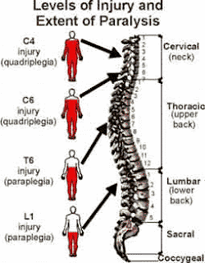
Background
Paraplegia is a condition that causes muscles to either be weak, or a person to not be able to use the hand or extremity easily due to loss of movement or sensation

Slide 6
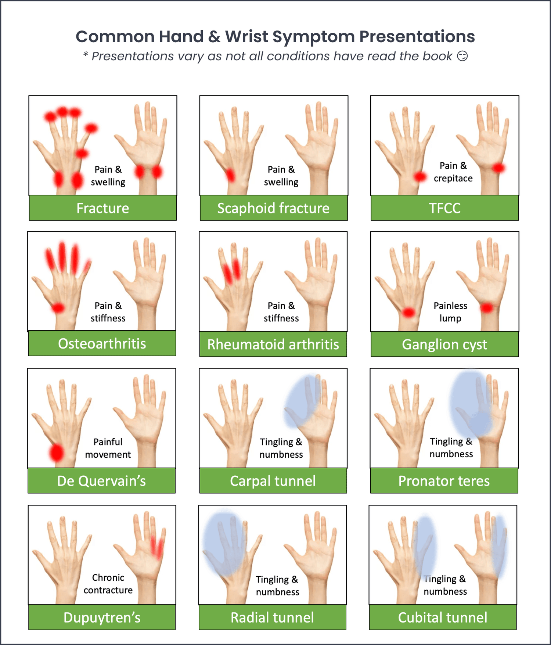
Background
Hand weakness is a condition that causes reduced strength with the muscles in the hand.

Slide 7

Background
Many kinds of people can experience these symptoms, such as those going through cancer treatment, going through the regular aging process, arthritis, carpal tunnel, tendinitis, or those going through diabetes experiencing the numbness and tingling that can be a symptom of the disease.

Slide 8

Assessment
“So, here’s my ASSESSMENT- These adaptive tools:
Silicone cupcake liner
Rubber jar opener
Piece of a pool noodle
Knotted rope dog toy
Velcro based grip assist devices
Grabbing device/grip assist device
Silicone kneading bag or two-gallon plastic freezer bag

Slide 9
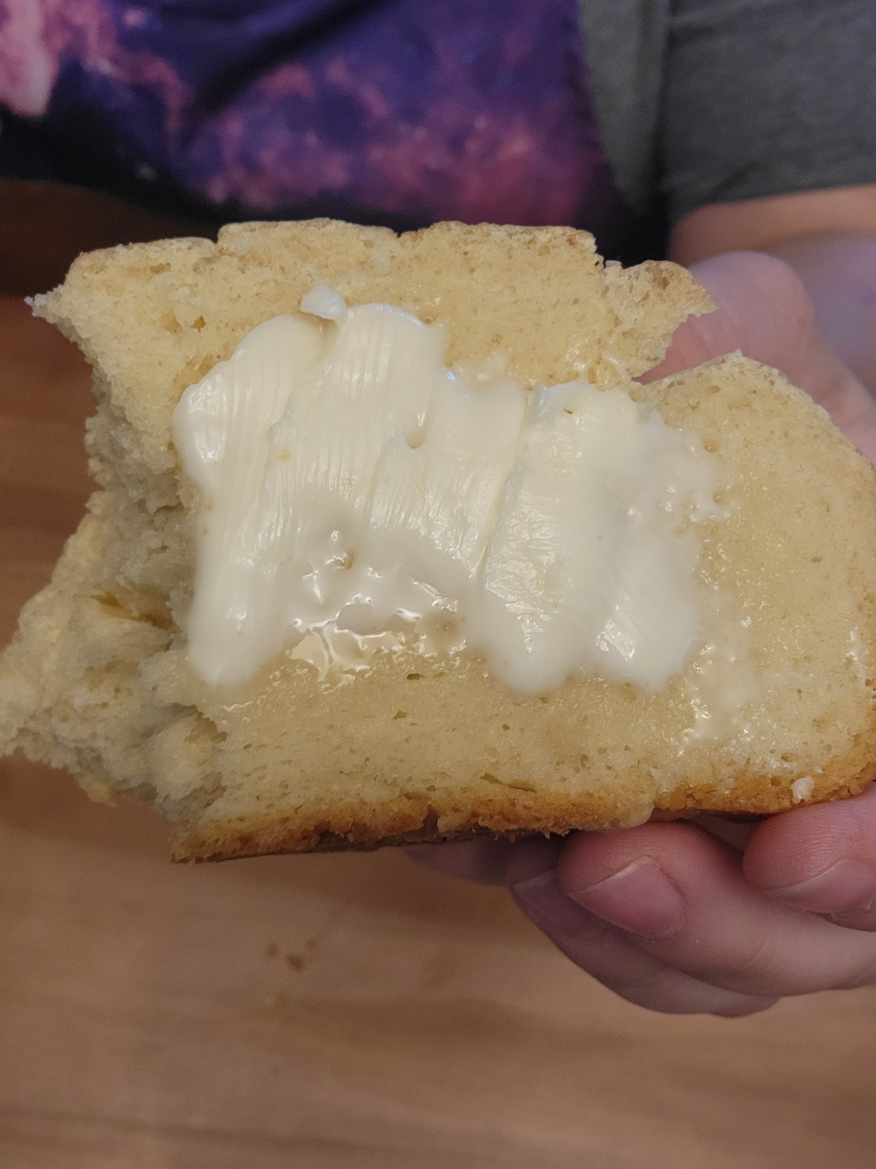
Assessment
Can help this person who has:
Paralysis
Spasticity
Hand-Foot Syndrome
Aging
Arthritis
Tendonitis
Muscle weakness
Neuropathy
Person has all the items to do this and needs instruction.

Slide 10
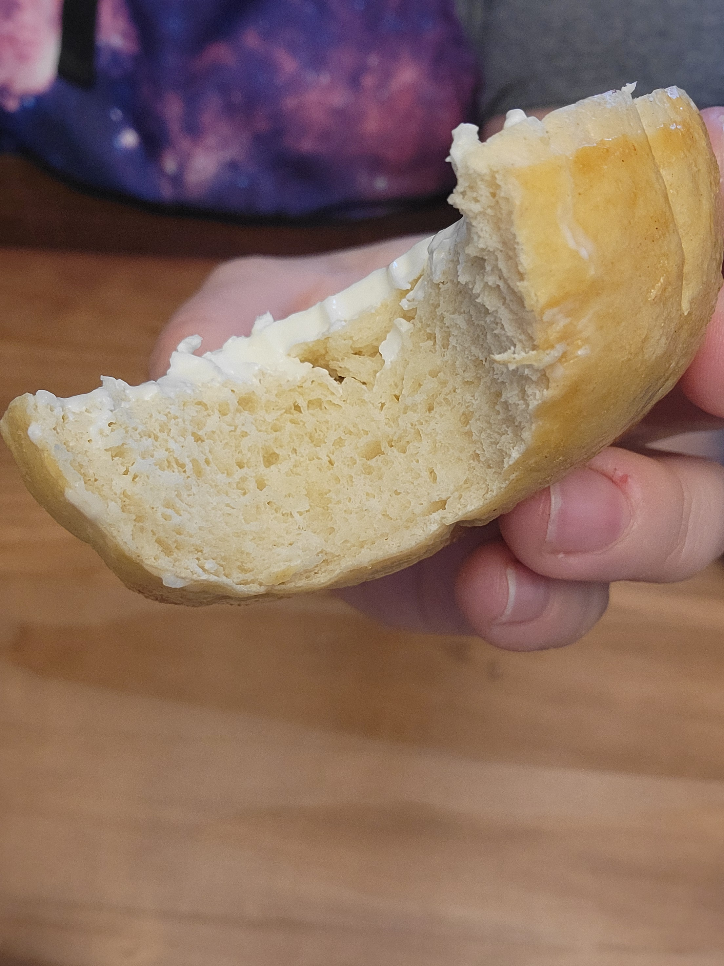
Recommendations
“Well, here’s my RECOMMENDATIONS”
“I’m going to show you how to make bagels right now, using these adaptive tools.”

Slide 11

Let’s Gather Our Supplies
Equipment:
Big bowl
Measuring Cup
Measuring spoons (teaspoon & tablespoon
Fork/whisk
Dough scrape
Knife
Nitrile gloves (optional)

Slide 12
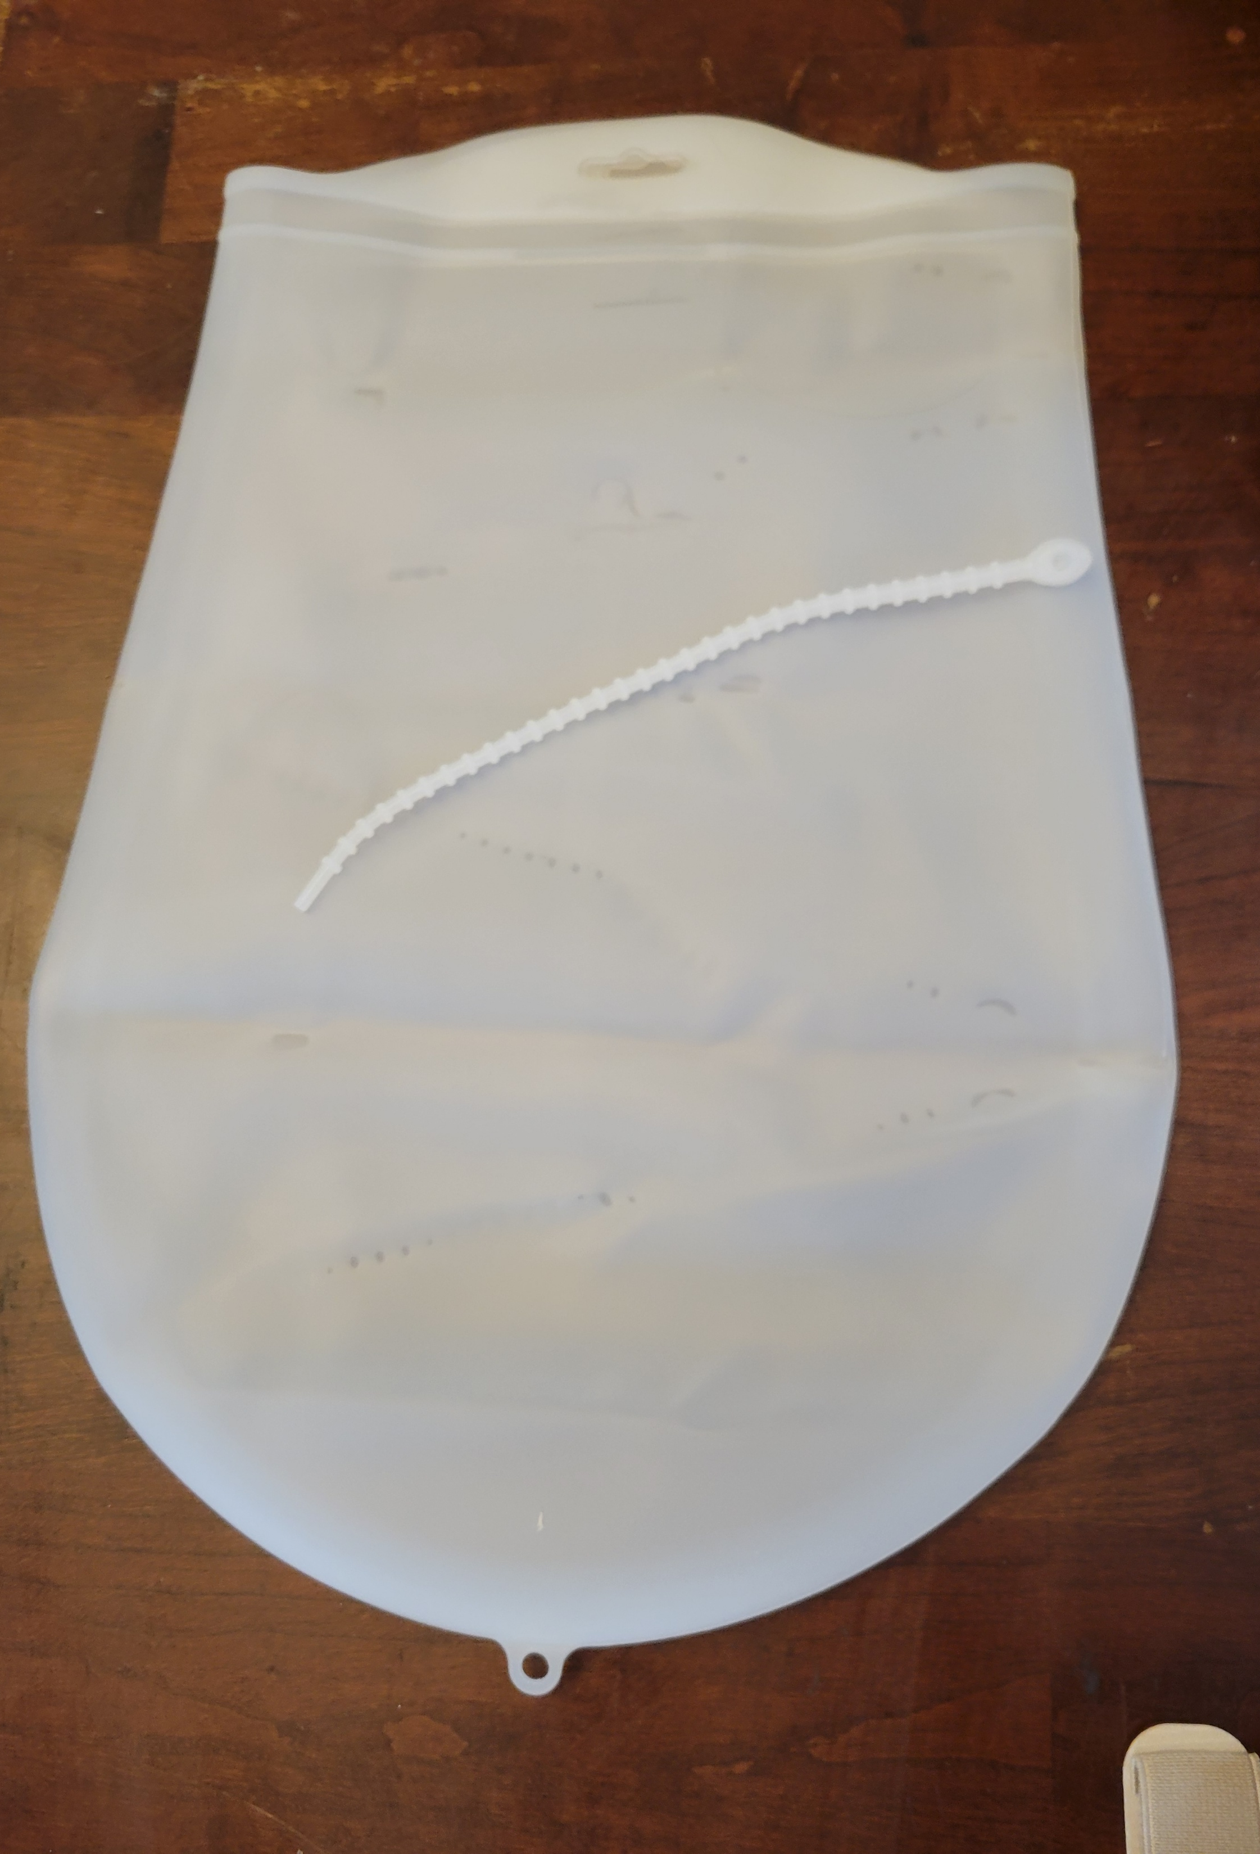
Let’s Gather Our Supplies
Adaptive Tools:
Silicone cupcake liner
Rubber jar opener
Piece of a pool noodle
Knotted rope dog toy
Velcro based grip assist devices
Grabbing device/grip assist device
Silicone kneading bag or two-gallon plastic freezer bag

Slide 13

Let’s Gather Our Supplies
Ingredients:
1 cup warm water/milk
2 ¼ teaspoon dry yeast
2 Tablespoons sugar or honey
2 Tablespoons oil olive oil, avocado oil (any neutral oil will work)
1 Beaten egg
3.5 – 4.5 cups bread flour or unbleached all-purpose flour
1 teaspoon salt
butter or egg wash (beaten egg and warm water mixture) optional for top of bread

Slide 14
Let’s do this!
Step 1: Set up workspace
Set up adaptive tools

Slide 15

Let’s do this!
Step 2 -
Measure your water/milk and warm it up to bath water temperature.
Don’t get it too hot or it’ll kill your yeast

Slide 16
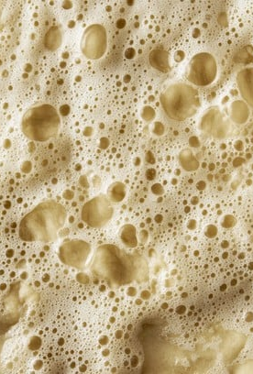
Let’s do this!
Step 3 -
Mix in your sugar, yeast, and salt into your milk/water. Put in your oil as well, and let sit for 10 minutes until foamy

Slide 17
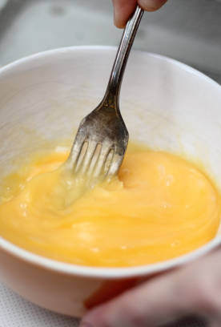
Let’s do this!
Step 4 -
Beat egg and set aside

Slide 18
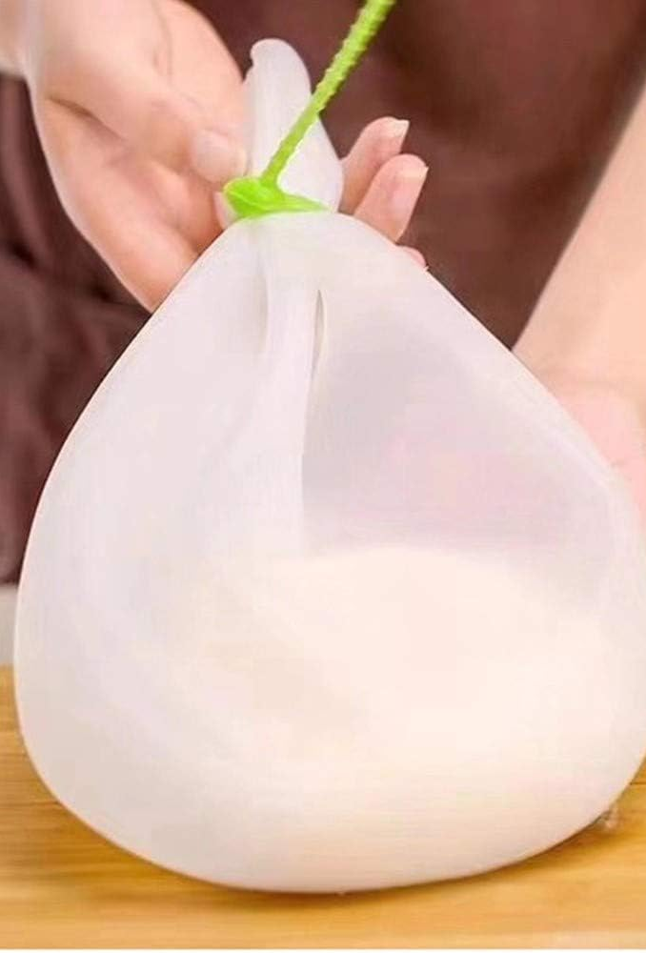
Let’s do this!
Step 5 -
Add flour into silicone or zip lock bag, pour in egg, and yeast/milk/water combination. Close/secure bag and knead until ingredients well combined (around 5-10 minutes).

Slide 19
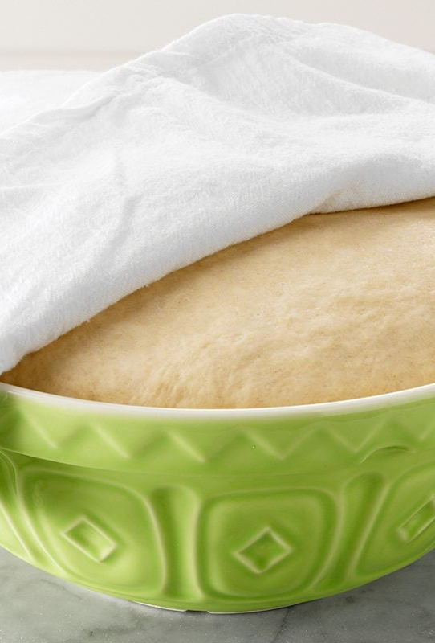
Let’s do this!
Step 6 -
Put dough into your oiled bowl. Flip it until the dough is covered in oil. Cover with towel and let dough rise for an hour.

Slide 20
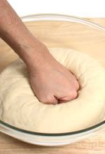
Let’s do this!
Step 7 -
After an hour, go ahead and dump dough out on a floured surface. Punch down, and shape into bagel (this recipe can make 12 smaller bagels, 8 regular sized, or 6 large sized bagels.

Slide 21
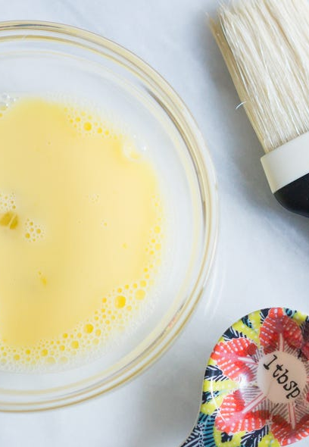
Let’s do this!
Step 8 -
Cover again, and let sit for 30 minutes – 1 hour
Go ahead and make your egg wash or melt your butter to brush on top of your dough

Slide 22
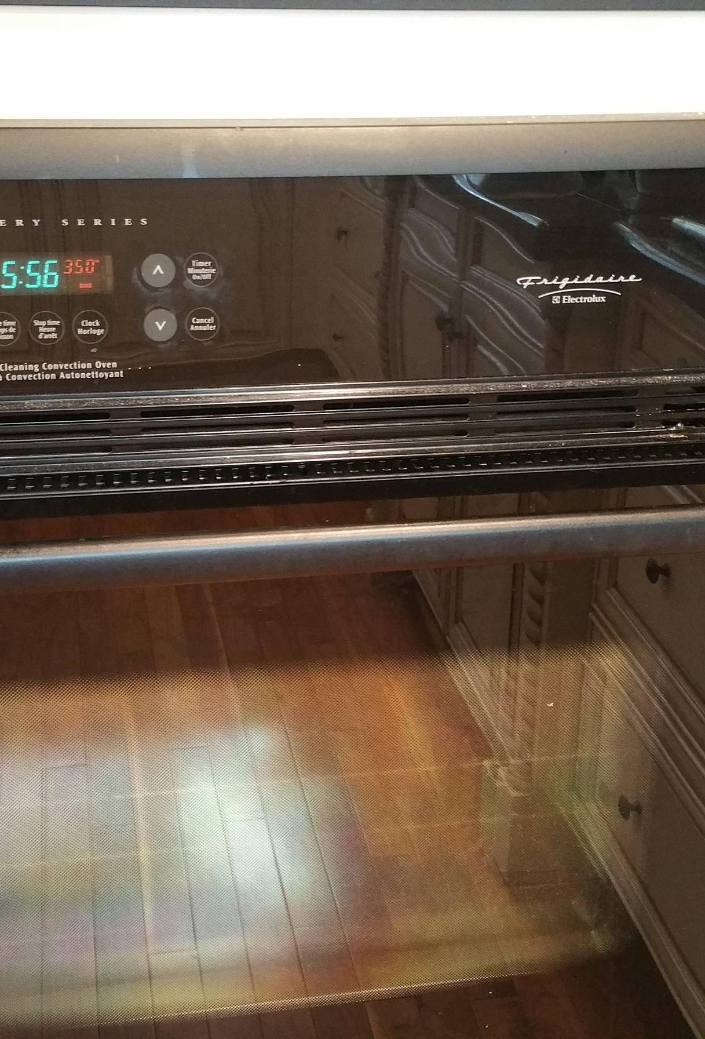
Let’s do this!
Step 9 -
Preheat oven to 375.
This Photo by Unknown Author is licensed under CC BY-SA

Slide 23
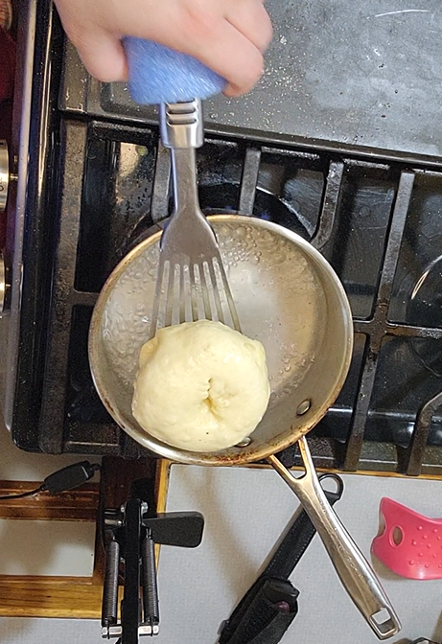
Let’s do this!
Step 10 -
Boil water. Do a ‘water bath’ (boil bagel on each side for 1 minute)

Slide 24
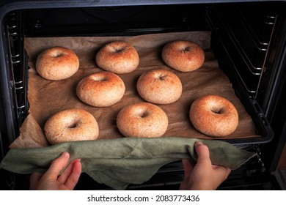
Let’s do this!
Step 11 -
Brush bagel with your butter or egg wash, and place in oven. Cook for 23-27 minutes.

Slide 25
Let’s do this!
Step 12-
Allow bagel to cool for 5 minutes. Enjoy!

Slide 26

Legal Statements
Just a REMINDER, this is all just me trying to be helpful- things I’ve witnessed as a nurse that I’ve seen help some people, and some of these situations are things I’ve gone through myself with either me or a loved one that I’ve had the joy of figuring out this worked for us.

Slide 27

Legal Statements
I am not affiliated with the education I provide links to, and they’re not affiliated with me.
I just used it to either make this education or found inspiration in it.

Slide 28

Legal Statements
Nothing I post here is meant to diagnose or medically treat people. If you do resonate with some of these symptoms and need additional information on if you could be experiencing this, make sure you talk to your doctor or medical team.

Slide 29

Legal Statements
Any opinions I express are my own, and not the opinions of an employer.”

